Slide 1




Community Mapping
AstronauticX

Slide 2

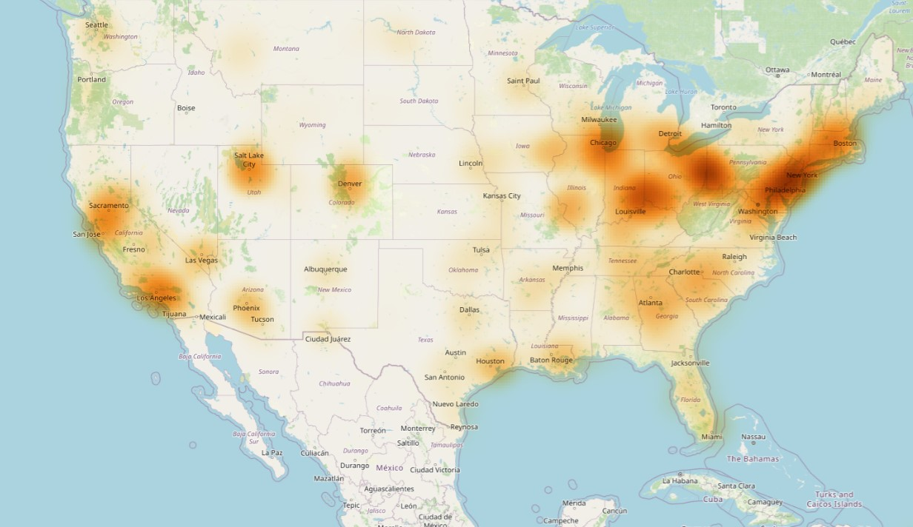
What is community mapping ?
Community mapping is a process where residents collaboratively create maps that visualize local issues, resources, and conditions. When focused on air pollution, it helps identify pollution sources, areas most affected, and potential solutions.

Slide 3
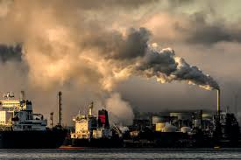


Objectives
Identify Pollution Sources
Highlight Vulnerable Areas
Engage the Community
Residents map out sources of air pollution, such as factories, highways, and areas with heavy traffic.
Mapping helps identify neighborhoods disproportionately affected by pollution, particularly those with vulnerable populations (e.g., children, elderly).
Involves community members in the decision-making process, empowering them to advocate for better air quality.

Slide 4



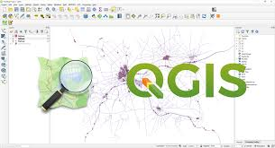
Tools and technologies
GIS Technology:
Geographic Information Systems (GIS) can be used to collect and analyze spatial data on air quality.
Surveys and Data Collection:
Community members can conduct surveys to gather information about local air quality perceptions and health impacts.
QGIS:
QGIS, or Quantum Geographic Information System, is a free, open-source software that allows users to create, edit, analyze, visualize, and publish geospatial data.

Slide 5





Benefits
Actionable Insights
Empowerment and Engagement
Community-Driven Solutions
Increased Awareness

Slide 6




Challenges in Community Mapping
Data Accuracy
Maintenance
Resource limitations
Inconsistency

Slide 7

Mapping Air pollution
Maps are a convenient way to represent such phenomena that need to be understood on a geographical scale . Pollution maps represent the intensity of pollutants in a static or time-varying way using animated visualization in such a manner that is intuitively interpretable .Real-time mapping of air quality provides great insights about spatio -temporal variation of air quality, which resultantly provides opportunity to take informed decisions and actions.

Slide 8
Essential for community mapping
Collects vital atmospheric data
Key to hotspot identification
Air Quality Data Sources
Local government datasets
NASA SPACE mission
Accurate data collection
Local government and environmental agencies provide air quality datasets, which are integral for identifying pollution hotspots.
The NASA SPACE mission gathers information on ocean color, airborne particles, and cloud properties, crucial for understanding air quality.
Accurate data collection is vital for pinpointing pollution hotspots, thereby aiding in effective community mapping and intervention.
Utilizing NASA and Local Agencies for Accurate Air Quality Mapping

Slide 9



Methodology
Community Mapping for Air Pollution: Utilizing GIS and QGIS
GIS and QGIS Utilization
Data Collection Sources
Employing GIS and QGIS software for effective data visualization and analysis.
Gathering air quality datasets from local government and environmental agencies.

Slide 10
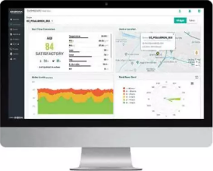
Purpose
The purpose of the mapping air pollution data is provide easily interpretable information to the user.
For general purposes, the most common type of heatmap is based on the AQI. However, based on the purpose of monitoring, different layers can be added to the base map.
As meteorological data is recorded at the monitoring sites, a layer of temperature, rainfall, wind speed, wind direction, and relative humidity can be added.
Additional analyses such as anomalies, indices. standard deviation, etc can also be calculated and represented as a heat map to understand the spatiotemporal trends of air quality.

